Slide 1
Multimedia: Making it Work
Chapter 15
Planning and Costing

Slide 2
Overview
The process of making multimedia.
Scheduling.
Estimating.
RFPs and bid proposals.

Slide 3
Planning and Costing
Before you begin a multimedia project, you must first develop a sense of its scope and content, letting the project take shape in your head as you think through the various methods available to get your message across to your viewers. Then you must develop an organized outline and a plan that is rational in terms of the skills, time, budget, tools, and resources you have at hand. Proper project planning is as important as planning the layout and content. Your plans should be in place before you start to render graphics, sounds, and other components, and you should refer to them throughout the project’s execution

Slide 4
The process of making multimedia
Idea analysis.
Pre-testing.
Task planning.
Development.
Delivery.

Slide 5
Idea analysis
Before beginning a multimedia project, it is necessary to determine its scope and content.
Balance is the key principle in idea analysis.
The aim is to generate a plan of action that will become the road map for production.

Slide 6
Idea analysis
It is necessary to continually weigh the purpose or goal against the feasibility and the cost of production and delivery.
This can be done dynamically by adding elements to or subtracting elements from a project.

Slide 7
Idea analysis
Additive process involves starting with minimal capabilities and gradually adding elements.
Subtractive process involves discarding unnecessary elements from a fully developed project.

Slide 8
Idea analysis
Idea analysis involves finding answers to questions like:
  Who is the intended audience? What are their needs?
  What multimedia elements will best deliver the message?
  What hardware, software, and storage capacity would be required?
  How much time, effort, and money would be needed?
  How will the final product be distributed?

Slide 9
Idea analysis
Project management software includes:
  Microsoft Project.
  Designer's Edge.
  Screenplay System's Screenwriter and StoryView.
  Outlining programs.
  Spreadsheets.

Slide 10
Idea analysis
CPM - Project management software typically provides Critical Path Method (CPM) scheduling functions to calculate the total duration of a project based upon each identified task, showing prerequisites.
PERT - Program Evaluation Review Technique (PERT) charts provide graphic representations of task relationships.
Gantt charts - depict all the tasks along a timeline.

Slide 11
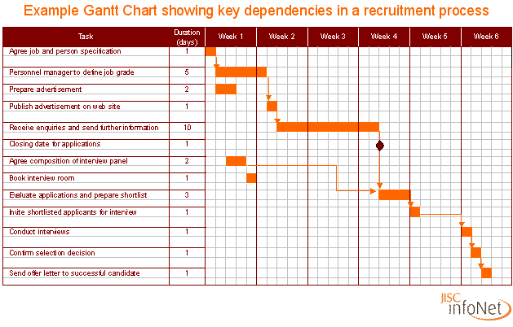

Slide 12
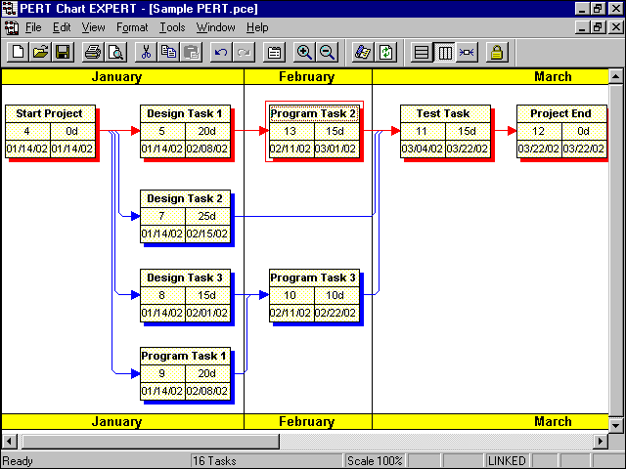

Slide 13
Pre-Testing
Involves defining project goals in fine detail and spelling out what it will take in terms of skills, content, and money to meet these goals.
Work up a prototype of the project on paper to help you relate your ideas to the real world.

Slide 14
Task Planning
Task planning involves:
  Designing the instructional framework.
  Holding creative idea sessions.
  Determining the delivery platform and authoring platform.
  Assembling the team.
  Building a prototype, producing audio and video, testing the functionality, and delivering the final product.

Slide 15
Development
Prototype development:
  Also known as a proof-of-concept or feasibility study.
  Involves testing of the initial implementation of ideas, building mock-up interfaces, and exercising the hardware platform.
  Trial calculations are possible after prototyping.
  A written report and an analysis of budgets allow the client some flexibility and also provide a reality check for developers.

Slide 16
Development
Alpha development – At this stage, the investment of effort increases and becomes more focused. More people get involved.
Beta development – At this stage, most of the features of a project are functional. Testing is done by a wider arena of testers.

Slide 17
Delivery
In the delivery stage, the project is said to be "going gold.”
The concerns shift towards the scalability of the project in the marketplace.

Slide 18
Scheduling
Milestones are decided at this stage.
The time required for each deliverable, that is the work products delivered to the client, is estimated and allocated.
Scheduling is difficult for multimedia projects because multimedia creation is basically artistic trial and error.
Scheduling is also difficult because computer hardware and software technology are in constant flux.

Slide 19
Scheduling
At this stage, clients need to approve or sign off on the work created.
Any revisions of previously approved material would require a change order.

Slide 20
Scheduling
A change order stipulates that the additional cost of revising previously approved material should be borne by the client.
When negotiating with a client, limit the number of revisions allowed.

Slide 21
Estimating
Cost estimation is done by analyzing the tasks involved in a project and the people who build it.
The hidden costs of administration and management are also included in the cost estimates.
A contingency rate of 10 to 15 percent of the total cost should be added to the estimated costs.

Slide 22
Estimating
Time, money, and people are the three elements that can vary in project estimates.
The time at which payments are to be made is determined and are usually made in three stages.

Slide 23
Estimating
The billing rate should be equal to the total cost plus a reasonable profit margin.
Typical billing rates for multimedia projects range from $60 to $150 an hour.
Lower rates do not necessarily imply poor quality of work; they could rather mean lower overheads.
The demand-supply mechanisms determine the prices.

Slide 24
Estimating
Contractors and consultants can be hired, but they should be billed at a lower rate.
Ensure that contractors perform the majority of their work off-site and use their own equipment to avoid classifying them as employees.

Slide 25
Estimating
The categories of expenses incurred for producing multimedia are:
    Project development costs.
    Production costs.
    Testing costs.
    Distribution costs.

Slide 26
Project Development Costs
These include:
  Salaries.
  Client meetings.
  Acquisition of content.
  Communication.

Slide 27
Project Development Costs
These include (continued):
  Travel.
  Research.
  Proposal and contract prep.
  Overheads.

Slide 28
Production Costs
Production costs can further be classified as:
  Management costs.
  Content acquisition costs.
  Content creation costs.
  Graphics production costs.
  Audio production costs.
  Video production costs.
  Authoring costs.

Slide 29
Testing Costs
These include:
  Salaries.
  Facility rental.
  Printing costs.
  Food and incentives.
  Coop fees (payment for participation).
  Editing.
  Beta program.

Slide 30
Distribution Costs
These include:
  Salaries
  Documentation
  Packaging
  Manufacturing
  Marketing
  Advertising
  Shipping

Slide 31
Estimating
Hardware:
  Hardware is the most common limiting factor for realizing a multimedia idea.
  List the hardware capabilities of the end-user's platform.
  Examine the cost of enhancing the delivery platform.
  The most common delivery platforms require a monitor resolution of 800X600 pixels and at least 16- bit color depth

Slide 32
RFPs and Bid Proposals
Request for Proposals (RFPs):
  These are formal and detailed documents from large corporations who are "outsourcing" their multimedia development work.
  They provide information about the scope of work and the bidding process.
  They are generally not very detailed and specific.

Slide 33
RFPs and Bid Proposals
Bid proposals:
  Should contain an executive summary or an overview.
  The backbone of the proposal is the estimate and project plan, which describes the scope of the work.
  The cost estimates for each phase or deliverable milestone and the payment schedules should also be included.

Slide 34
RFPs and Bid Proposals
Bid proposals (continued):
  Should contain the graphic and interactive goals of the project.
  Prepare a brief synopsis if a project is complicated.
  Lists the terms and conditions of the contract.

Slide 35
RFPs and Bid Proposals
Bid proposals (continued):
  The terms of a contract should include a description of the billing rates, invoicing policy, third-party licensing fees, and a disclaimer for liability and damages.
  Design the proposal according to a client's expectations.
  A proposal should appear plain and simple, yet businesslike.

Slide 36
RFPs and Bid Proposals
Bid proposals (continued):
  A table of contents or an index is a straightforward way to present the elements of a proposal in condensed overview.
  Need analysis and description describes the reasons the project is being put forward.
  It is necessary to describe the target audience and the target platform.

Slide 37
RFPs and Bid Proposals
Bid proposals (continued):
  Creative strategy – This section describes the look and feel of a project. This is useful if the reviewing executives were not present for the preliminary discussions.
  Project implementation – This section contains a detailed calendar, PERT and Gantt charts, and lists of specific tasks with associated completion dates, deliverables, and work hours.

Slide 38
Summary
Before beginning a project, determine its scope and content.
The process of making multimedia involves idea analysis, pre-testing, task planning, development, and delivery.
Costs related to multimedia creation are categorized as project development costs, production costs, testing costs, and distribution costs.

